Slide 1
Project Capstone Coursera

Slide 2
Agenda
1) Introduction
2) Data
3) Methodology
4) Results

Slide 3
Introduction
At airport, there are many restaurants, each restaurant represents a kind of taste. In this homework, I will collect all the china airports data and restaurants data, then cluster each airport by restaurant’s taste.

Slide 4
data
The dataset to explore China airports from wikipedia site: https://en.wikipedia.org/wiki/List_of_airports_in_China
In addition to the dataset from the wikipedia page, each airport will have complementary data from GeoPy's geocoding web services. Using the Geocoder API is possible collect longitude and latitude for each airports.
We get airport geographical position using the Foursquare location data and then select restaurant with category equal "Food" near to the each airport.
In this link is possible identify all available categories: https://developer.foursquare.com/docs/resources/categories

Slide 5
methodology
The first step was to collect from the wikipedia page the list of China airports: Airport Name, City, and Code. We then run an API call to get the geographic location with the longitude and latitude data for each airport and add them to the airport list.
The next step was to run the Foursquare API to identify restaurant with the category "Food" within a radius of 1000 meters close to each airport. This information was stored in a second list. Then the list of airports and the venue list were merged to begin the analysis exploring.
The first analysis was the segmentation of the type of restaurant for each airport and the identification of the 5 most common categories of restaurants in the airports.
The second analysis used the K-means method to cluster the airports into 3 groups according to the restaurants category.

Slide 6
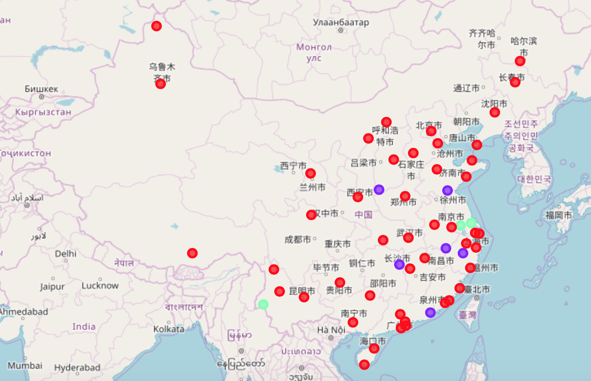
Results: China airports segment

Slide 7
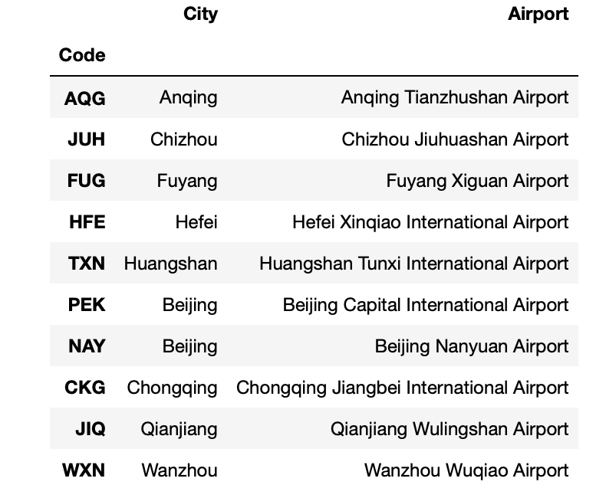
Results: China airport list

Slide 8
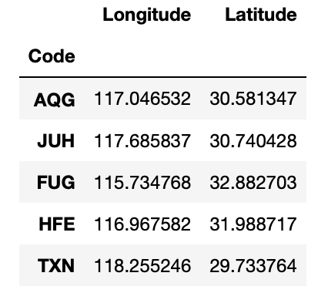
Results: China airport geographical position

Slide 9
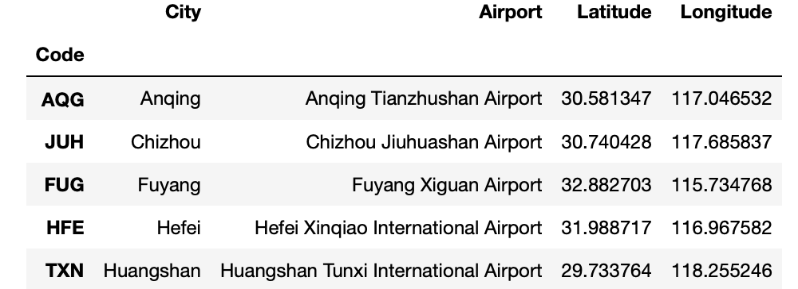
Results: Combine result

Slide 10
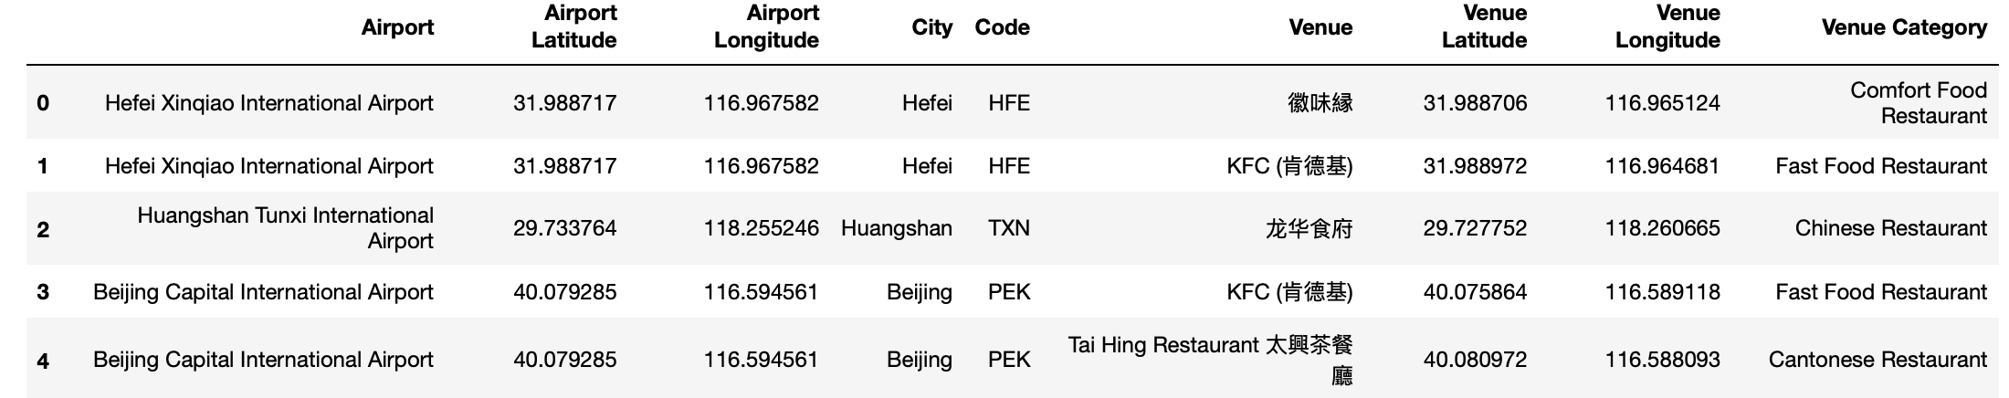
Results: Restaurant result

Slide 11
Results: Restaurant result

Slide 12
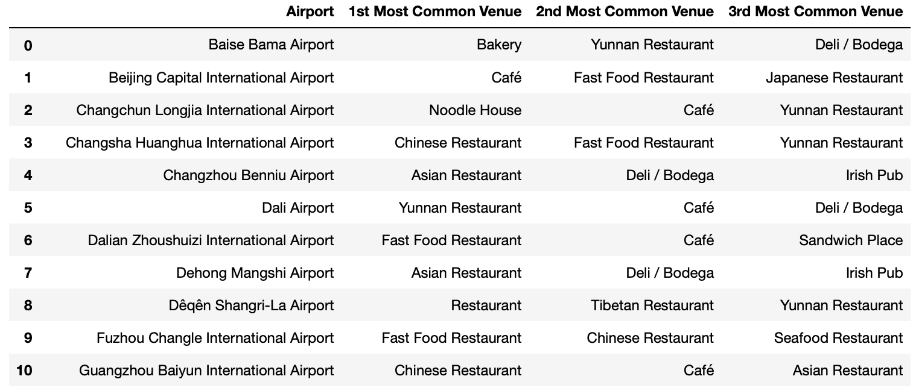
Results: Top 3 Restaurants for each airport

